Slide 1

Distributed Operating Systems
Process Synchronisation
Submitted to Dr. PARVATHI R
SUBMITTED BY:
Gaurav Deswal 18MCA1014
Apoorv Srivastava 18MCA1046
Subrata Sahoo 18MCA1072

Slide 2
Process Synchronisation
Synchronization is important if we want to
control access to a single, shared resource
agree on the ordering of events

Slide 3
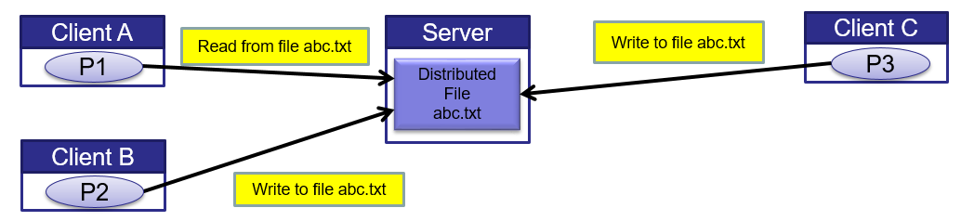
Mutual exclusion
Distributed processes need to coordinate to access shared resources.
Example : writing a file in a Distributed File System
In uniprocessor systems, mutual exclusion to a shared resources is provided through shared variables or operating system support.
In Distributed System, processes coordinate access to a shared resource by passing messages to enforce distributed mutual exclusion

Slide 4
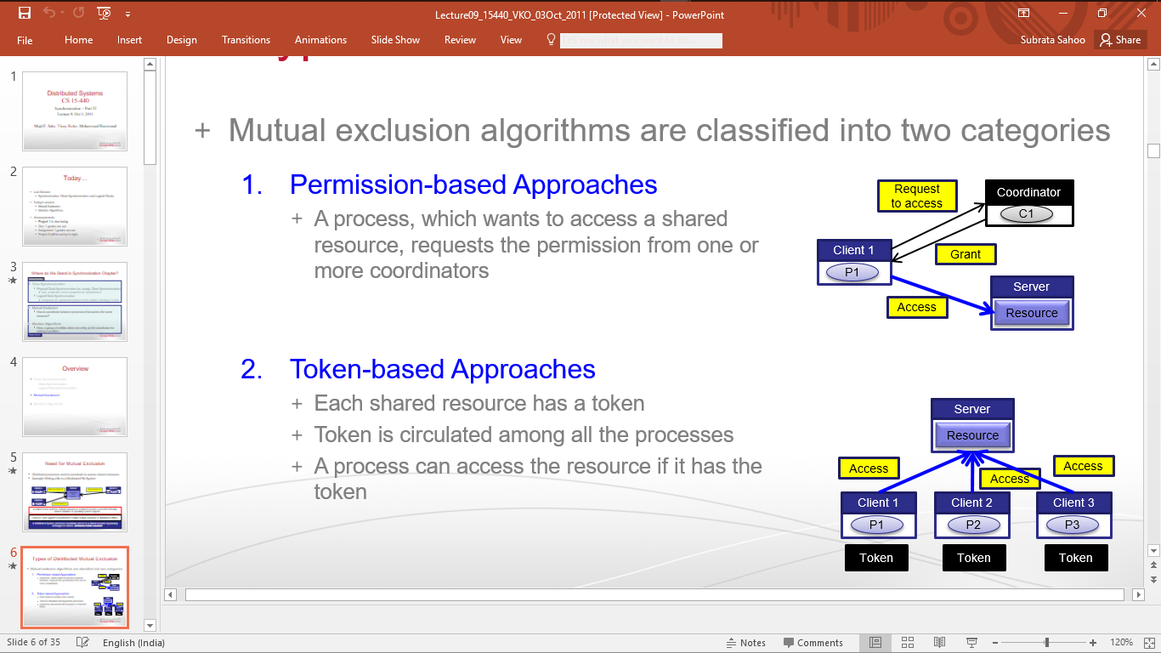
Types of Distributed Mutual Exclusion
Permission-based Approaches:
A process which wants to access a shared resource, requests the permission from one or more coordinators.
Token-based Approaches:
Each shared resource has a token
Token is circulated among all the processes
A process can access the resource if it has the token.

Slide 5
Token based approach: Token ring
Each resource is associated with a token.
The token is circulated among processes.
The processes with the token can access the resource.
Token ring approach avoids starvation.

Slide 6
Election Algorithms
If we are using one process as a coordinator for a shared resource how do we select that one process?

Slide 7
Solution – an Election
All processes currently involved get together to choose a coordinator
If the coordinator crashes or becomes isolated, elect a new coordinator
If a previously crashed or isolated process, comes on line, a new election may have to be held

Slide 8
Assumptions and Requirements
Any process can call for an election.
A process can call for at most one election at a time.
Multiple processes can call an election simultaneously.
The result of an election should not depend on which process calls for it.
The non-faulty process with the best (highest) election attribute value (e.g., highest id or address, or fastest cpu, etc.) is elected.
Requirement: A run (execution) of the election algorithm must always guarantee at the end:
Safety: ∀ P (P’s elected = (q: non-failed process with the best attribute
value) or ⊥)
Liveness: ∀ election( (election terminates)
& ∀ P: non-faulty process, P’s elected is not ⊥ )

Slide 9
Election Algorithms
Wired systems
Bully algorithm
Ring algorithm

Slide 10
Bully Algorithm
A node initiates election by sending an “election” message to only nodes that have a higher id than itself.
A node that receives an “election” message replies with answer, & starts an election – unless it has already.
When a process finds the coordinator has failed, if it knows its id is the highest, it elects itself as coordinator, then sends a coordinator message to all processes with lower identifiers.

Slide 11
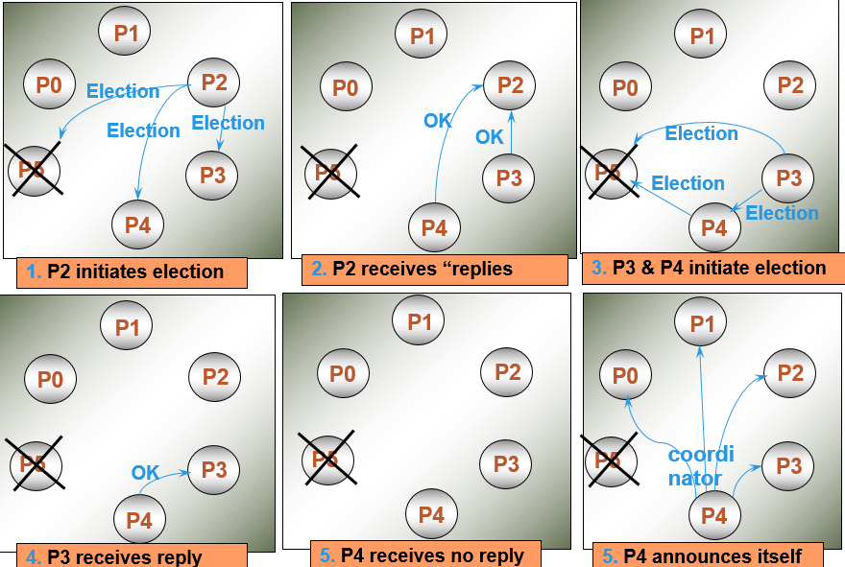
Example: Bully Election

Slide 12
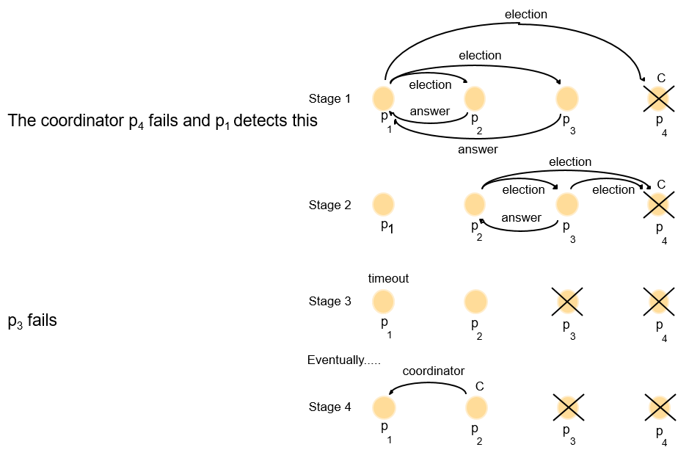
The Bully Algorithm

Slide 13
Performance of Bully Algorithm
Best case scenario: The process with the second highest id notices the failure of the coordinator and elects itself.
N-2 coordinator messages are sent.
Turnaround time is one message transmission time.
Worst case scenario: When the process with the least id detects the failure.
N-1 processes altogether begin elections, each sending messages to processes with higher ids.
The message overhead is O(N²).
Turnaround time is approximately 5 message transmission times if there are no failures during the run: election, answer, election, answer, coordinator

Slide 14
Conclusion
The processes with the token can access the resource.
Token ring approach avoids starvation.
Coordination requires a leader process, e.g., sequencer for total ordering in multicasts, bank database example, coordinator-based mutual exclusion.
Leader process might fail
Need to (re-) elect leader process
Three Algorithms
Ring algorithm
Modified Ring algorithm
Bully Algorithm

